Slide 1

Lending Case Study
Submitted by Prasanna B
Akshay Bhaskar

Slide 2
Problem statement and Objectives
Problem Statement: When a Consumer Finance Company receives a loan application, the company has to make a decision for loan approval based on the applicant’s profile. Two types of risks are associated with the bank’s decision:
- If the applicant is likely to repay the loan, then not approving the loan results in a loss of business to the company
- If the applicant is not likely to repay the loan, i.e. he/she is likely to default, then approving the loan may lead to a financial loss for the company
Objectives
Understanding the driving factors (or driver variables) behind loan default
Explain the results of univariate and bivariate analysis in business terms
Crucial insights along with visualisations

Slide 3
Analysis Approach
Data Understanding
Data Cleaning
Univariate analysis
Insights & Conclusion
Bivariate Analysis
Segmented Univariate

Slide 4
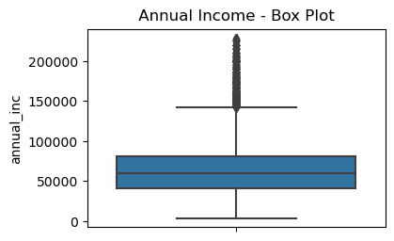
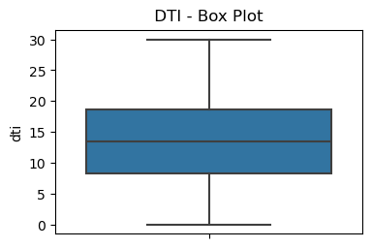
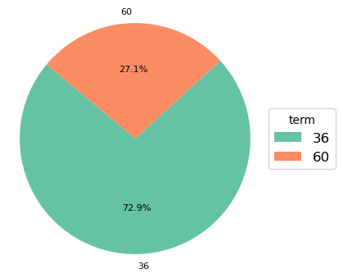
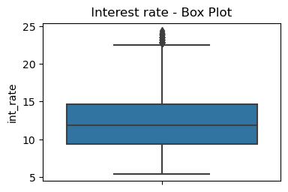
Important Data Overview
Majority of DTI is between 10 and 20. DTI - A ratio calculated using the borrower’s total monthly debt payments on the total debt obligations, excluding mortgage and the requested LC loan, divided by the borrower’s self-reported monthly income.
36 term loan is high(73%) compared to 60 month term loan
Majority of borrowers have annual income between 48000 and 80000
Majority of loans have interest rates between 10% and 15%

Slide 5
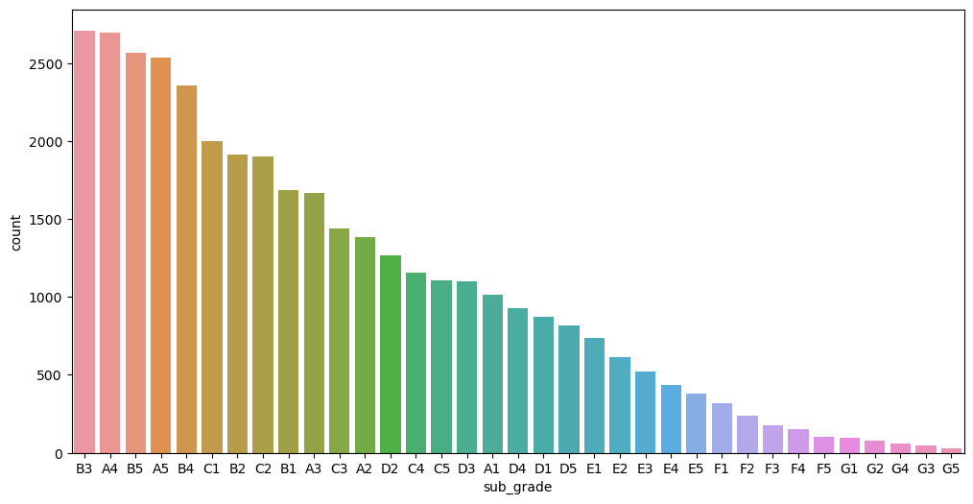
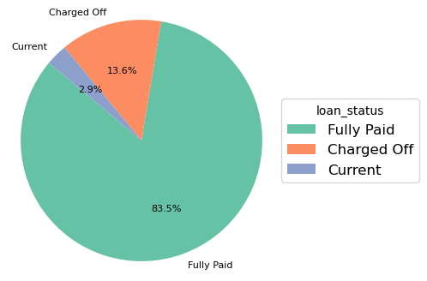
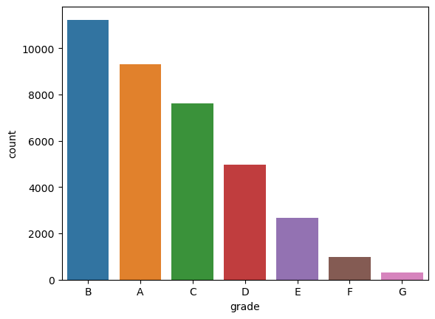
Important Data Overview
High sub grades are given more loans
83% loans are fully paid and 13.5% are default loans
High grades are give more loans, B being the top grade

Slide 6
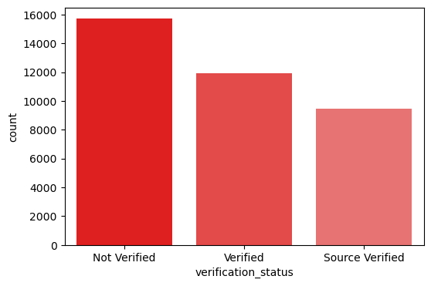
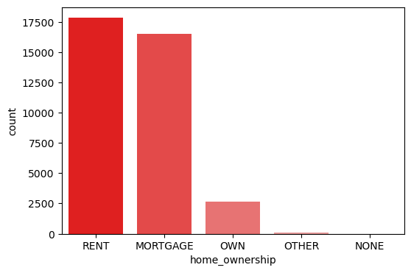
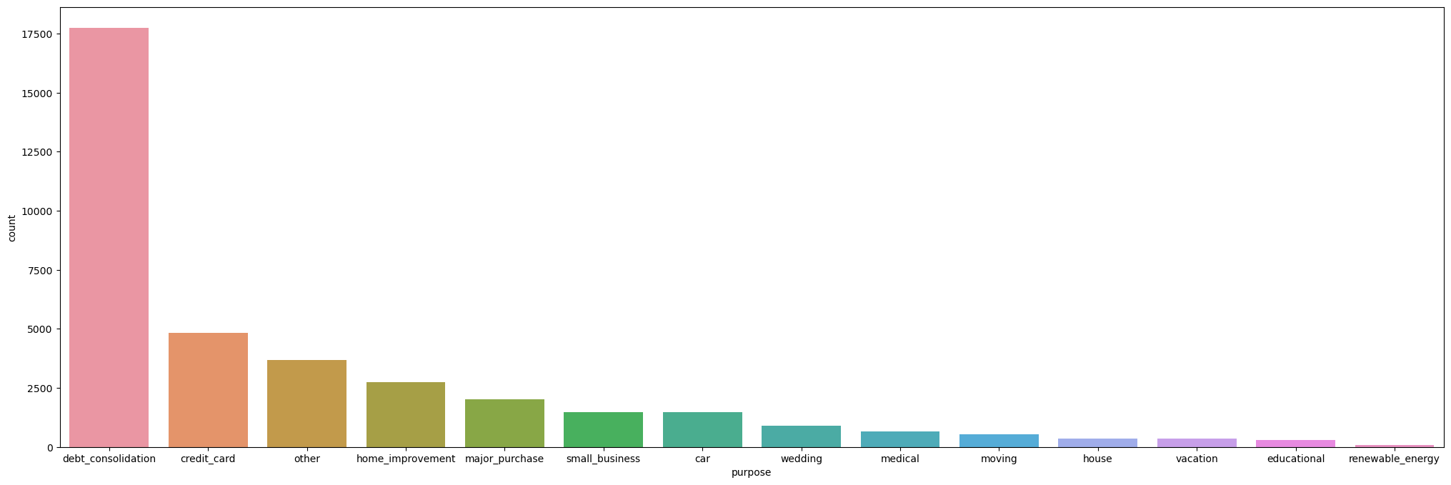
Important Data Overview
There are substantial amount of loans that are not verified
Majority of borrowers have home ownership status as Rent or Mortgage
Debt_consolidation is the biggest reason for taking a loan

Slide 7
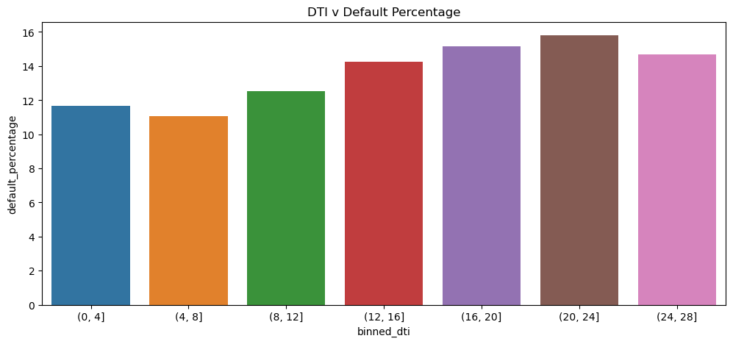
Segmented Univariate Analysis
Higher dti bins have higher default percentages.
Note: DTI - A ratio calculated using the borrower’s total monthly debt payments on the total debt obligations, excluding mortgage and the requested LC loan, divided by the borrower’s self-reported monthly income.

Slide 8
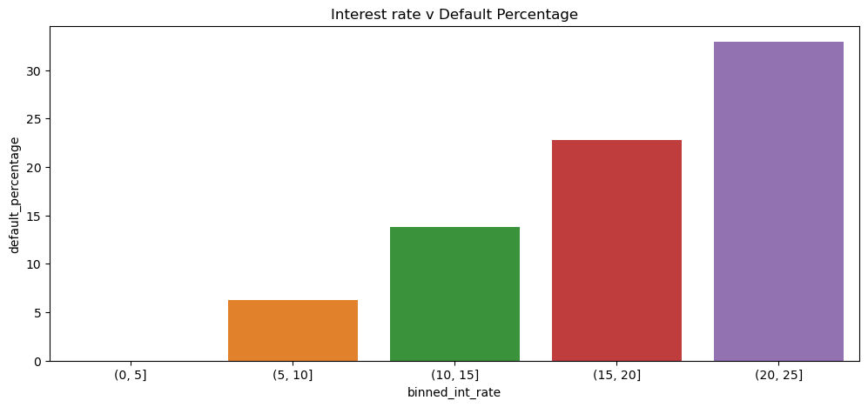
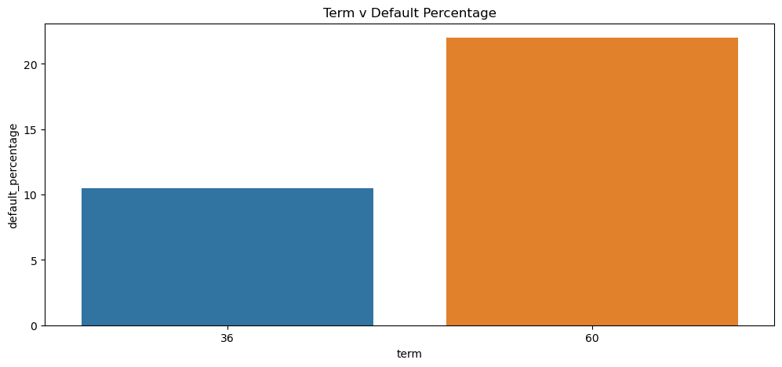
Segmented Univariate Analysis
Higher interest rates have higher default percentage
60 month term has high default percentage than 36 term loans

Slide 9
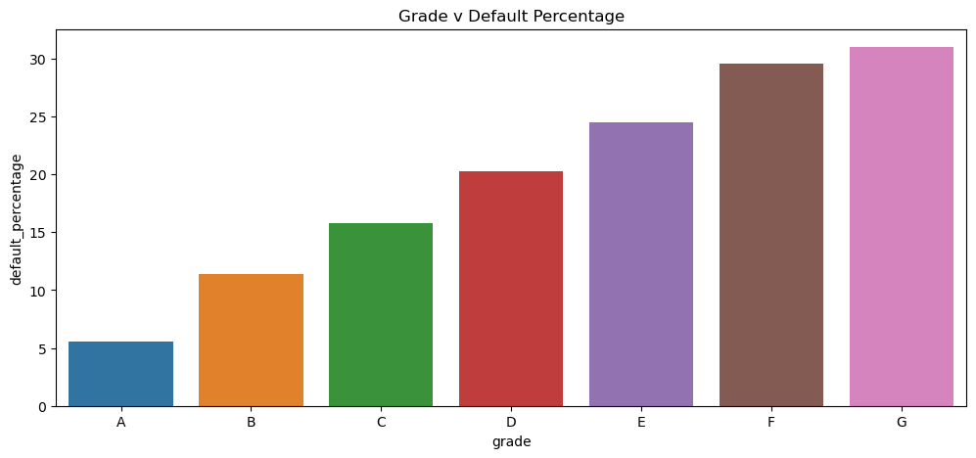
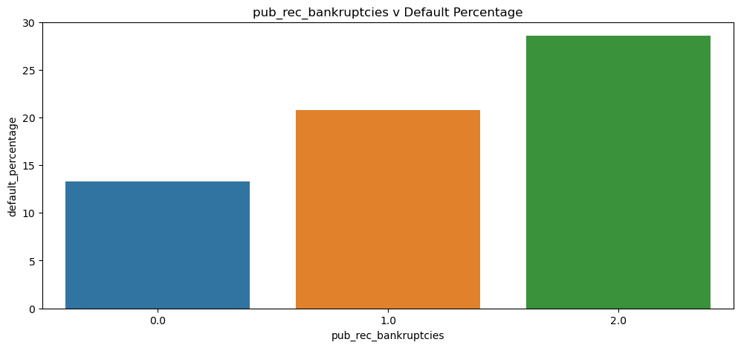
Segmented Univariate Analysis
Default percentage increases as grade increases from A to G
Similar pattern is observed for sub grades
Members with public record bankruptcies have high default percentages

Slide 10
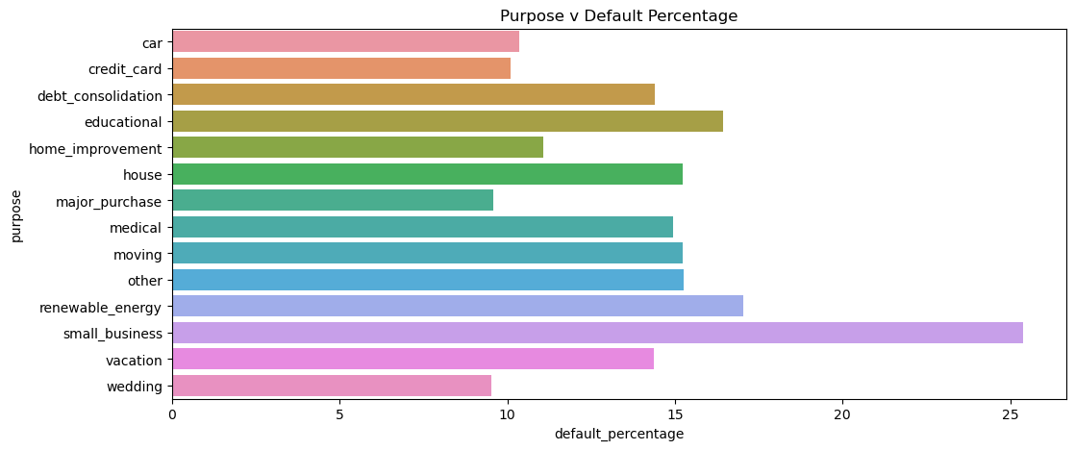
Segmented Univariate Analysis
Small business have higher default percentage than any other purpose

Slide 11
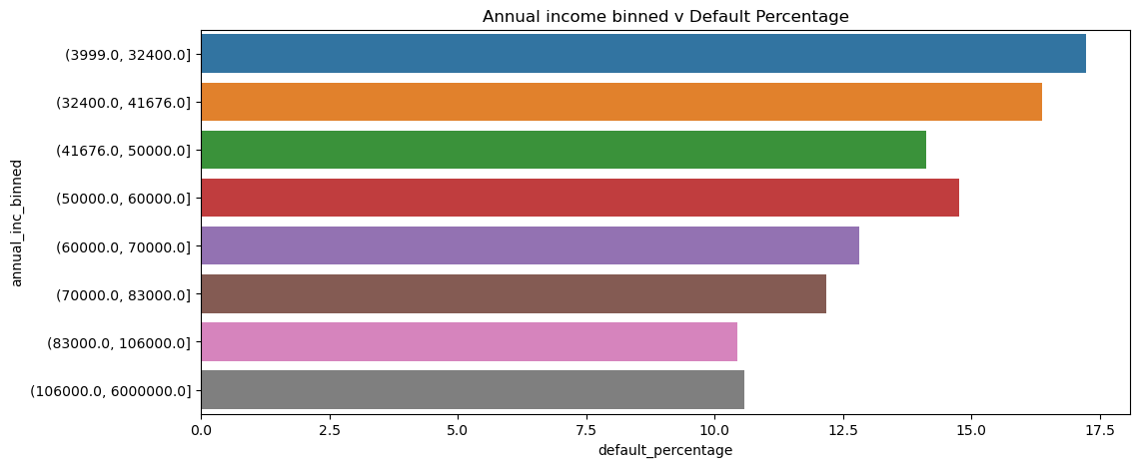
Segmented Univariate Analysis
Lower annual income bins have higher default percentages

Slide 12
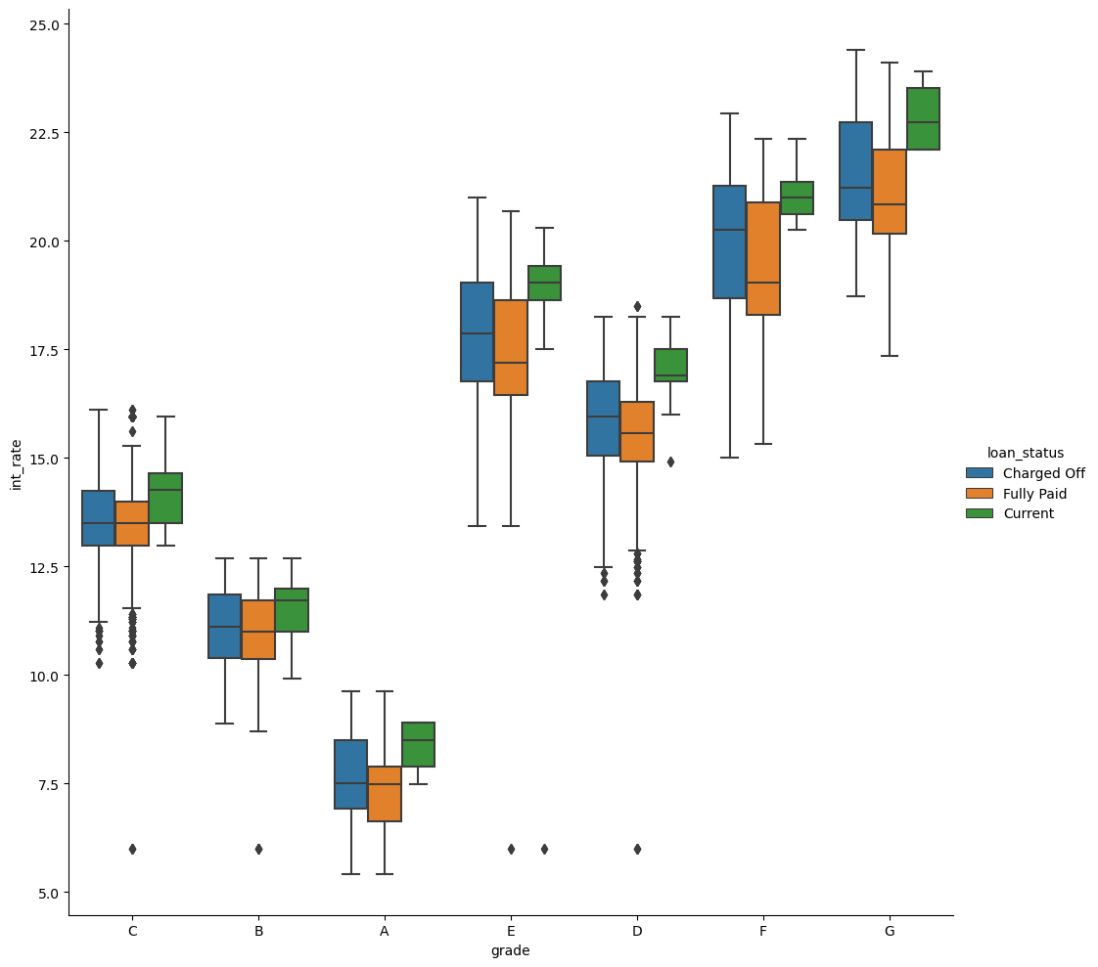
Bivariate Analysis
Default percentage is high with respect to lower loan grades G,F,E

Slide 13
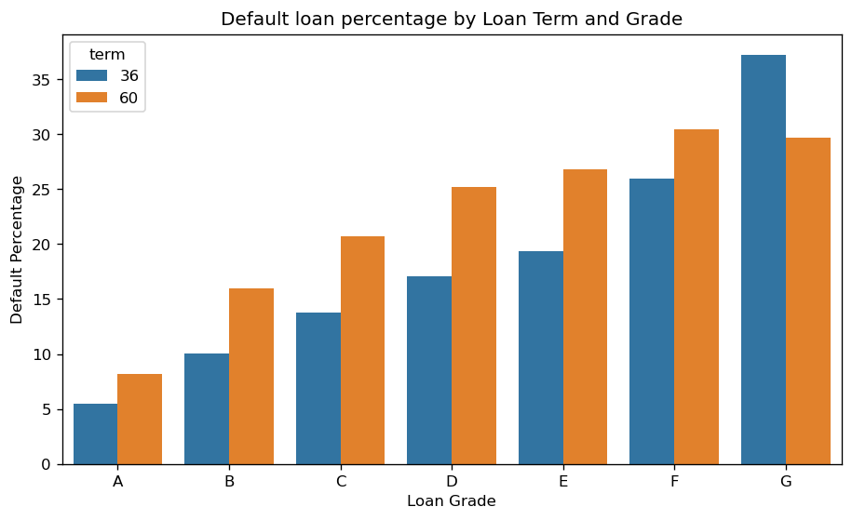
Bivariate Analysis
Loan default ratio of Grade A till E are irrespective of loan terms
Grade G shows greater default percentage for 36 months term plan

Slide 14
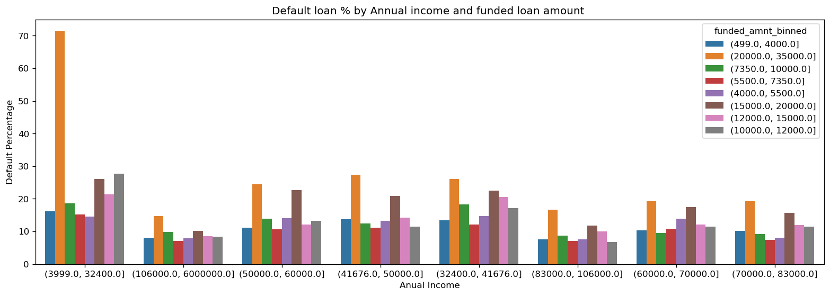
Bivariate Analysis
The above shows binned annual income , binned funded amount and Default Percentage analysis
If funded loan amount is above 20,000 USD for customer with < 30,000 USD annual income, they are most likely to default

Slide 15
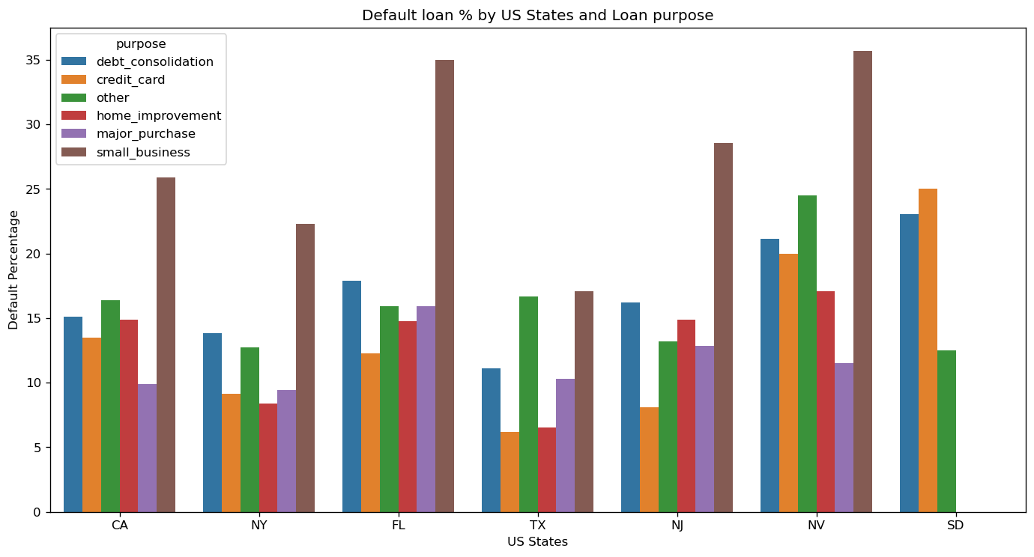
Bivariate Analysis
Small business are likely to default across any region

Slide 16
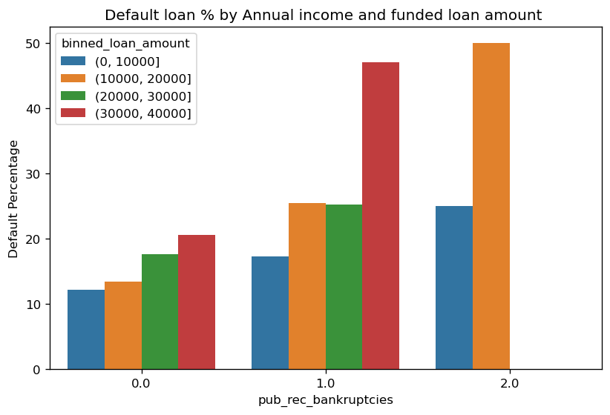
Bivariate Analysis
Customers with 1 public bankruptcy record and annual income between 30000 and 40000 have very high default percentage
Customers with 2 public bankruptcy record and annual income between 10000 and 20000 have very high default percentage

Slide 17
Conclusions
Recommendations
Based on the observation above following are major driving factors
Grade
Sub_grade
Purpose
Loan amount
Annual income
Public bankruptcy record
Avoid Public bankruptcy record borrowers
For each grade, loans should be give to top grades. Focus on A & B subgrades(A4, B3 etc) as they apply for most loans and less default
Small business owners should be given loans with caution
Avoid high amount long term loans
Avoid giving higher loan amounts to F&G grades
Avoid high dti ratio borrowers as they tend to default
Avoid giving high amount loans to lower annual income(<25,000 USD)

